Slide 1
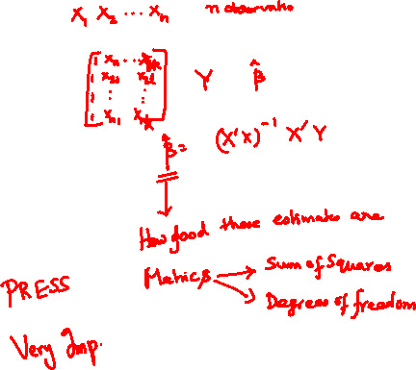
Linear Regression Part 2
Date: 25th May 2026
Topics
Degrees of Freedom
Residual Variance
Resolution of Sum of Squares
Finding R² and Adjusted R²
Variance-Covariance Matrix

Slide 2

Actual response and its prediction
Express the deviation between an actual response $(Yi)$ and the predicted response (${\hat{Y}}_{i})$ in terms of difference of two deviations
Deviation of actual response from mean response $\overline{Y}$:
$Yi$-$\overline{Y}$
Deviation of predicted response from mean response:
$${\hat{Y}}_{i}−\overline{Y}$$

Slide 3

How to Find Mean Response?
$$\overline{Y}=\frac{\sum_{i=1}^{n}{Y_{i}}}{n}$$
Interesting Aside: It may be shown that the mean of the predicted responses is the same as the mean of the actual (experimental) responses
$$\overline{Y}=\frac{\sum_{i=1}^{n}{{\hat{Y}}_{i}}}{n}= \overline{\hat{Y}}$$

Slide 4
Relation between actual response and its prediction
Deviation of actual response from mean response
Deviation of predicted response from mean response

Slide 5
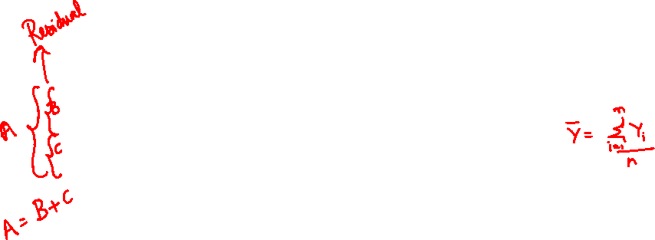
(X_{i}, Y_{i})
Y_{i}
X_{i}

Slide 6


Sum of Squares
It may be shown that
$$\sum_{i=1}^{n}{{\left(Y_{i}−\overline{Y}\right)}^{2}=\sum_{i=1}^{n}{{\left(Y_{i}−{\hat{Y}}_{i}\right)}^{2}+}\sum_{i=1}^{n}{{\left({\hat{Y}}_{i}−\overline{Y}\right)}^{2}}}$$
This amounts to
Sum of Squares of the Deviations of the Responses from the Mean =
Sum of Squares of the Residuals + Sum of Squares due to Regression

Slide 7
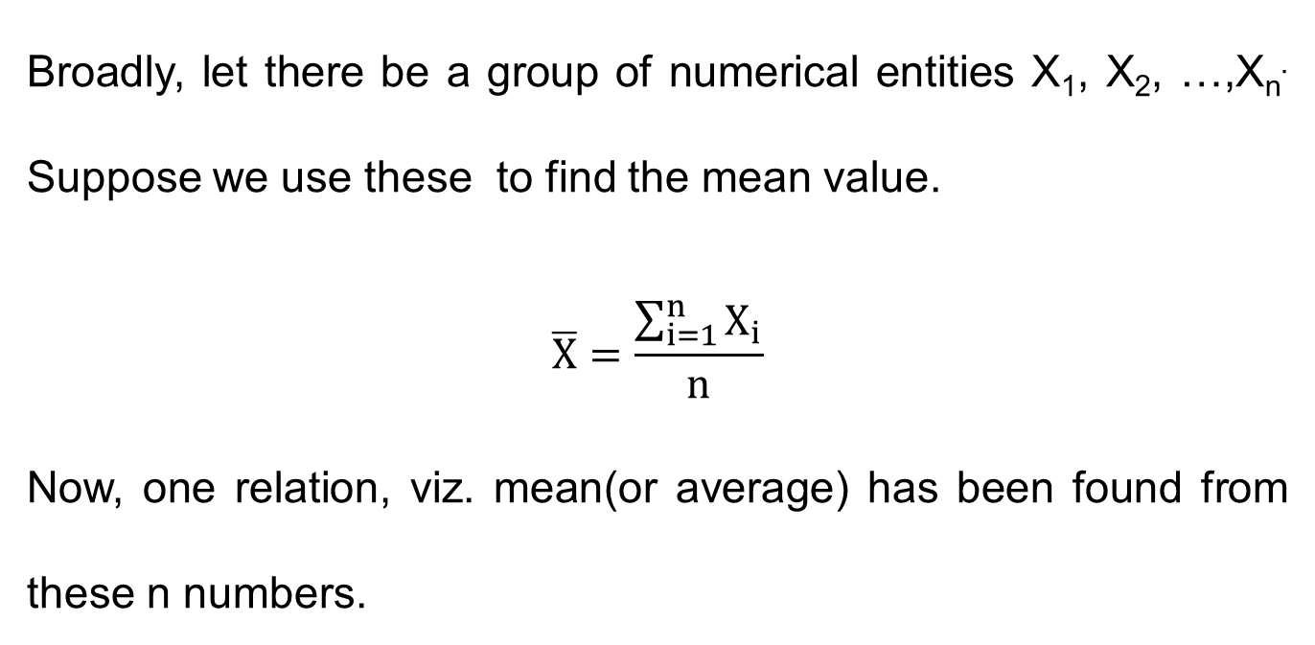
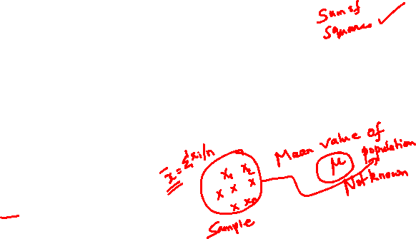
Degrees of Freedom (DOF)
Broadly, let there be a group of numerical entities X₁, X₂, …,X_{n}. Suppose we use these to find the mean value.
$$\overline{X}=\frac{\sum_{i=1}^{n}{X_{i}}}{n}$$
Now, one relation, viz. mean(or average) has been found from these n numbers.

Slide 8
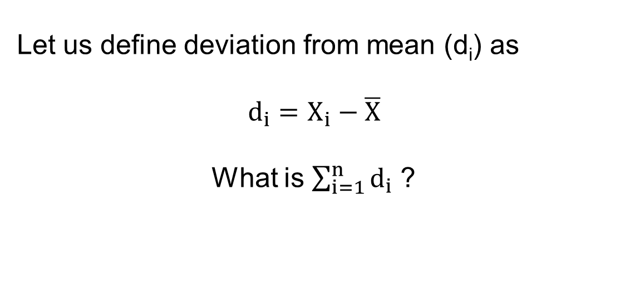
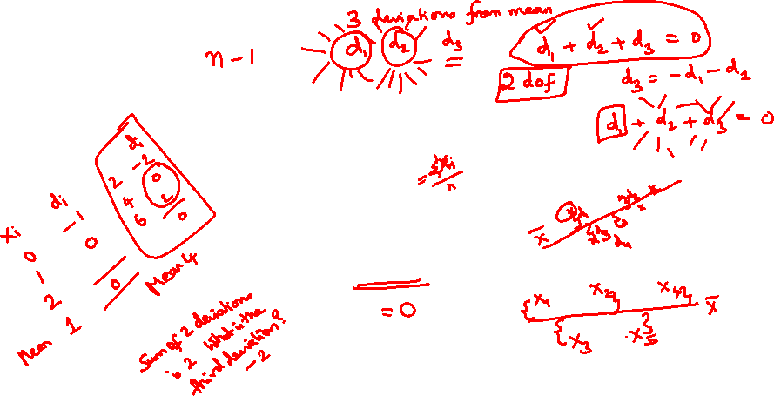
Sum of Deviations from the Mean
Let us define deviation from mean (d_{i}) as
$$d_{i}=X_{i}−\overline{X}$$
What is $\sum_{i=1}^{n}{d_{i}}$ ?

Slide 9


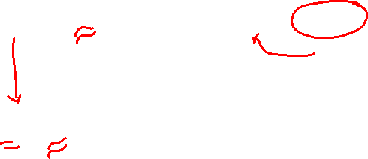
Sum of Deviations from the Mean
Let us define deviation from mean (d_{i}) as
$$d_{i}=X_{i}−\overline{X}$$
$$\sum_{i=1}^{n}{d_{i}}=\sum_{i=1}^{n}{X_{i}}−\sum_{i=1}^{n}{\overline{X}}$$
$$\sum_{i=1}^{n}{d_{i}}=n\overline{X}−n\overline{X}=0$$
Hence, sum of deviations equals zero.
$$\overline{x}=\frac{\sum_{i=1}^{n}{X_{i}}}{n}$$

Slide 10
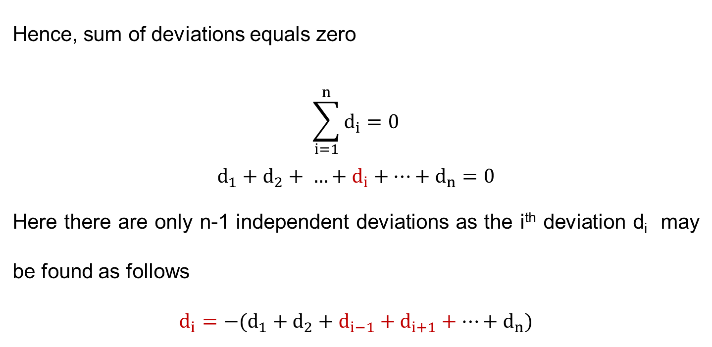

Sum of Deviations from the Mean
Hence, sum of deviations equals zero
$$\sum_{i=1}^{n}{d_{i}}=0$$
$$d_{1}+d_{2}+ …+d_{i}+…+d_{n}=0$$
Here there are only n-1 independent deviations as the i^{th} deviation d_{i} may be found as follows
$${d_{i}=−(d}_{1}+d_{2}+d_{i−1}+d_{i+1}+…+d_{n})$$

Slide 11
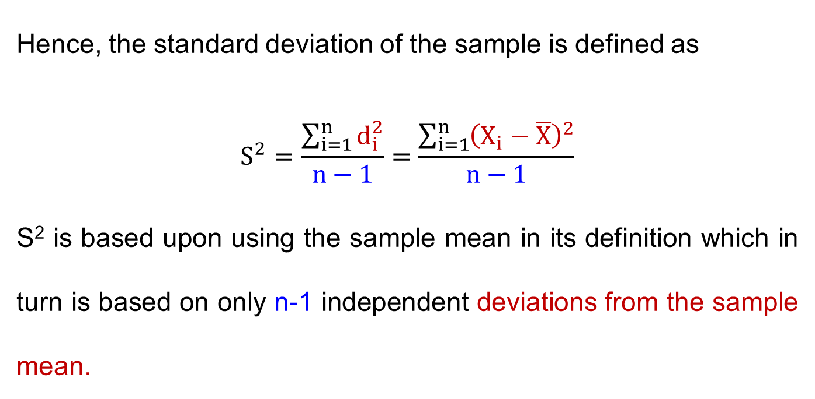
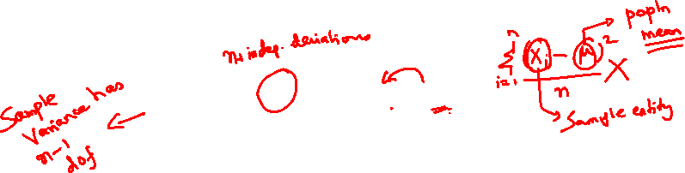
Sample Standard Deviation S²
Hence, the standard deviation of the sample is defined as
$$S^{2}=\frac{\sum_{i=1}^{n}{d_{i}^{2}}}{n−1}=\frac{\sum_{i=1}^{n}{{\left(X_{i}−\overline{X}\right)}^{2}}}{n−1}$$
S² is based upon using the sample mean in its definition which in turn is based on only n-1 independent deviations from the sample mean.

Slide 12
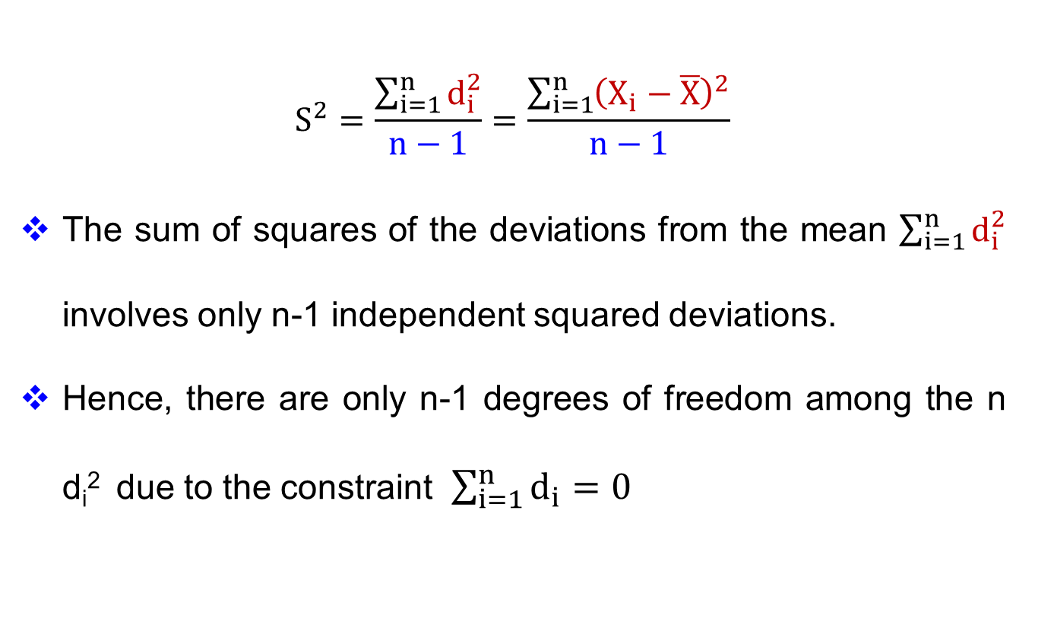
Sample Standard Deviation S²
$$S^{2}=\frac{\sum_{i=1}^{n}{d_{i}^{2}}}{n−1}=\frac{\sum_{i=1}^{n}{{\left(X_{i}−\overline{X}\right)}^{2}}}{n−1}$$
The sum of squares of the deviations from the mean $\sum_{i=1}^{n}{d_{i}^{2}}$ involves only n-1 independent squared deviations.
Hence, there are only n-1 degrees of freedom among the n d_{i}² due to the constraint $\sum_{i=1}^{n}{d_{i}}=0$

Slide 13
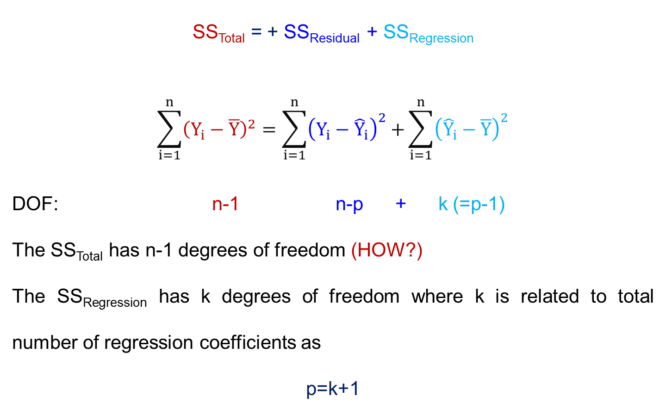
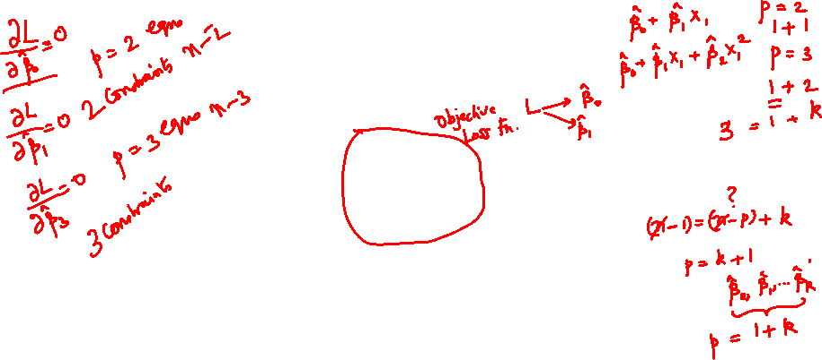
Degrees of Freedom
SS_{Total} = + SS_{Residual} + SS_{Regression}
$$\sum_{i=1}^{n}{{\left(Y_{i}−\overline{Y}\right)}^{2}=\sum_{i=1}^{n}{{\left(Y_{i}−{\hat{Y}}_{i}\right)}^{2}+}\sum_{i=1}^{n}{{\left({\hat{Y}}_{i}−\overline{Y}\right)}^{2}}}$$
DOF: n-1 n-p + k (=p-1)
The SS_{Total} has n-1 degrees of freedom (HOW?)
The SS_{Regression} has k degrees of freedom where k is related to total number of regression coefficients as
p=k+1

Slide 14
Omitting β_{o}
Hence, it may be seen that the parameter β_{o} has been omitted from the regression sum of square and
Only the partial regression coefficients β₁, β_{2,} … β_{k} have been included

Slide 15
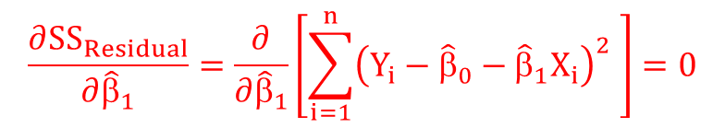
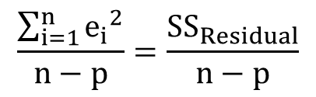

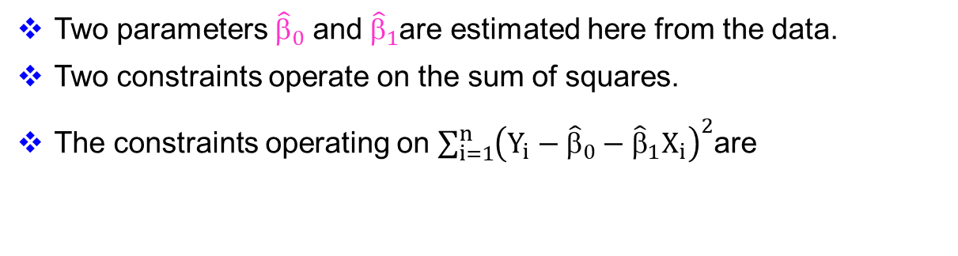
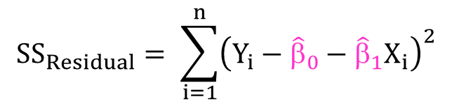
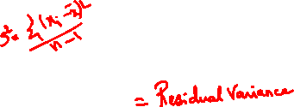
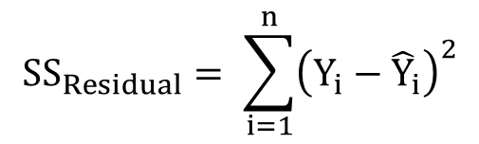
Why n-p in SS_{Residual}?
$${SS}_{Residual}= \sum_{i=1}^{n}{{\left(Y_{i}−{\hat{Y}}_{i}\right)}^{2}}$$
$$\frac{\sum_{i=1}^{n}{{e_{i}}^{2}}}{n−p}=\frac{{SS}_{Residual}}{n−p}$$
$${SS}_{Residual}= \sum_{i=1}^{n}{{\left(Y_{i}−{\hat{β}}_{0}−{\hat{β}}_{1}X_{i}\right)}^{2}}$$
Two parameters ${\hat{β}}_{0}$ and ${\hat{β}}_{1}$are estimated here from the data.
Two constraints operate on the sum of squares.
The constraints operating on $\sum_{i=1}^{n}{{\left(Y_{i}−{\hat{β}}_{0}−{\hat{β}}_{1}X_{i}\right)}^{2}}$are
$$\frac{∂{SS}_{Residual}}{∂{\hat{β}}_{0}}=\frac{∂}{∂{\hat{β}}_{0}}\left[\sum_{i=1}^{n}{{\left(Y_{i}−{\hat{β}}_{0}−{\hat{β}}_{1}X_{i}\right)}^{2} }\right]=0$$
$$\frac{∂{SS}_{Residual}}{∂{\hat{β}}_{1}}=\frac{∂}{∂{\hat{β}}_{1}}\left[\sum_{i=1}^{n}{{\left(Y_{i}−{\hat{β}}_{0}−{\hat{β}}_{1}X_{i}\right)}^{2} }\right]=0$$

Slide 16
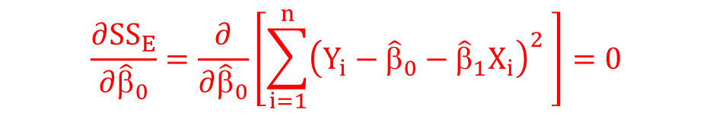
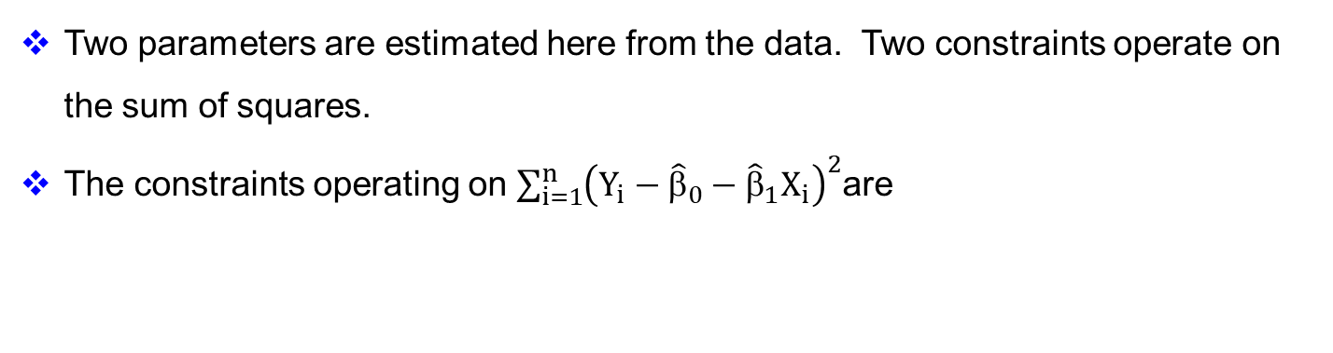
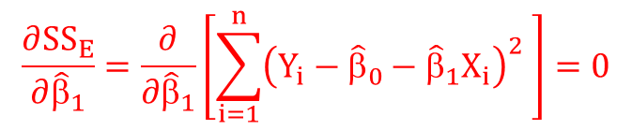
Why n-p?
Two parameters are estimated here from the data. Two constraints operate on the sum of squares.
The constraints operating on $\sum_{i=1}^{n}{{\left(Y_{i}−{\hat{β}}_{0}−{\hat{β}}_{1}X_{i}\right)}^{2}}$are
$$\frac{∂{SS}_{E}}{∂{\hat{β}}_{0}}=\frac{∂}{∂{\hat{β}}_{0}}\left[\sum_{i=1}^{n}{{\left(Y_{i}−{\hat{β}}_{0}−{\hat{β}}_{1}X_{i}\right)}^{2} }\right]=0$$
$$\frac{∂{SS}_{E}}{∂{\hat{β}}_{1}}=\frac{∂}{∂{\hat{β}}_{1}}\left[\sum_{i=1}^{n}{{\left(Y_{i}−{\hat{β}}_{0}−{\hat{β}}_{1}X_{i}\right)}^{2} }\right]=0$$

Slide 17
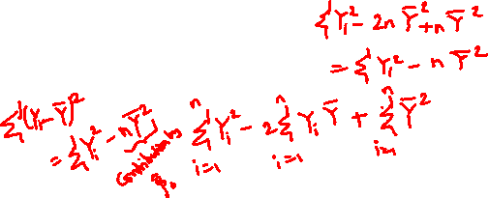
Analysis of Variance (ANOVA)
Source of Variation | Sum of Squares | Degrees of Freedom
Regression | SS_{Regression} | k = p-1
Residual | SS_{Residual} | n-p
Total | SS_{Total} | n-1

Slide 18
Source of Variation | Sum of Squares | Degrees of Freedom
Regression | SS_{Regression} | k
Residual | SS_{Residual} | n-p
Total | SS_{Total} | n-1
Here n is the total number of observations and p is the total number of parameters (including the constant β_{o}).
Since k = (n-1) – (n-p)
k = p-1

Slide 19

Definition of Total Sum of Squares
The total sum of squares is defined as
$${SS}_{total}=\sum_{i=1}^{n}{{\left(Y_{i}−\overline{Y}\right)}^{2}}$$

Slide 20
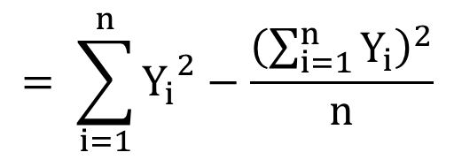
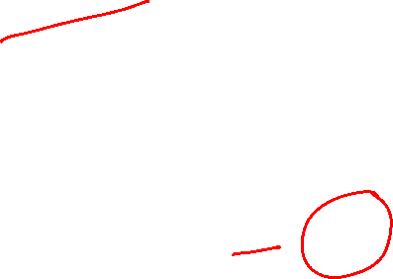
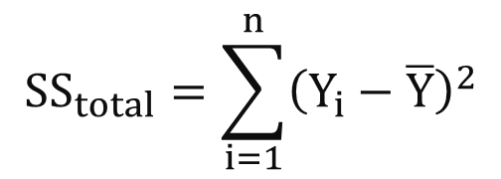

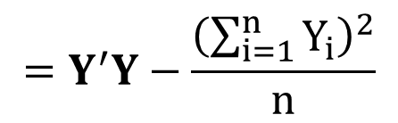
Derivation of Total Sum of Squares
$${SS}_{total}=\sum_{i=1}^{n}{{\left(Y_{i}−\overline{Y}\right)}^{2}}$$
$$= \sum_{i=1}^{n}{{Y_{i}}^{2}−\frac{{\left(\sum_{i=1}^{n}{Y_{i}}\right)}^{2}}{n}}$$
$$=Y^{′}Y−\frac{{\left(\sum_{i=1}^{n}{Y_{i}}\right)}^{2}}{n}$$
$$SS_{Total}=Y^{′}Y−n{\overline{Y}}^{2}$$

Slide 21
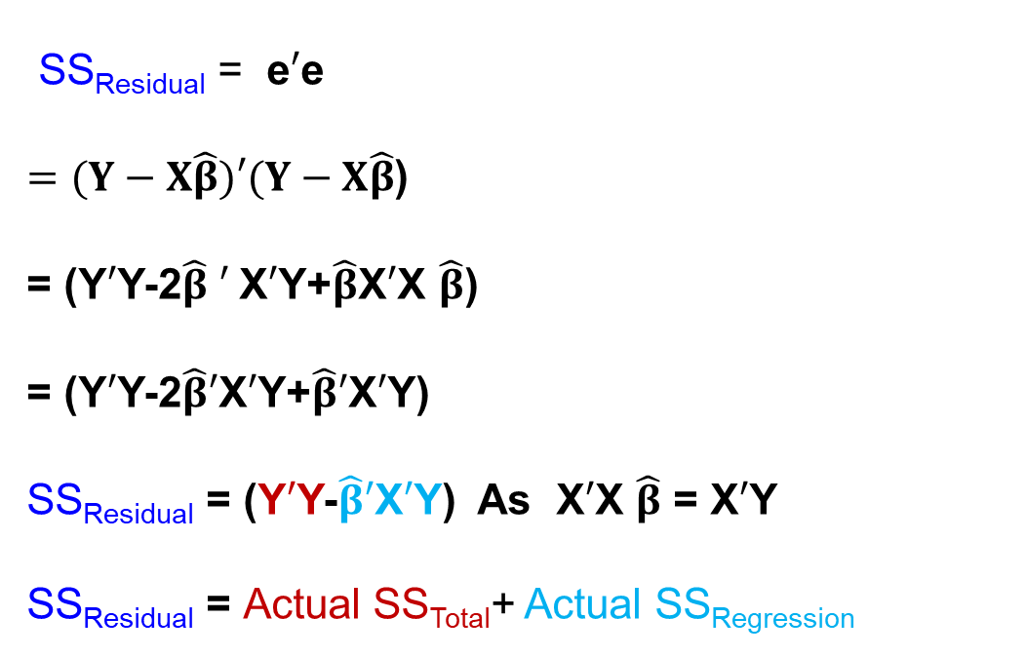
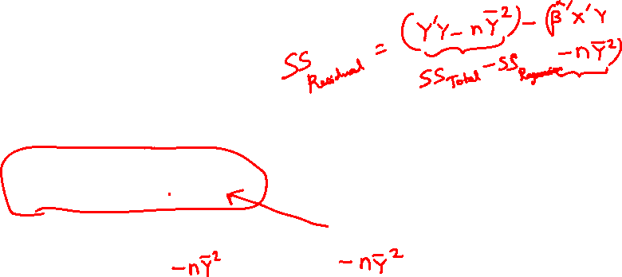
Derivation for Actual Regression Sum of Squares
SS_{Residual} = e$′$e
$=(Y−X\hat{β})′(Y−X\hat{β}$)
= (Y$′$Y-2$\hat{β}$ $′$X$′$Y+$\hat{β}$X$′$X $\hat{β}$)
= (Y$′$Y-2$\hat{β}′$X$′$Y+$\hat{β}′$X$′$Y)
SS_{Residual} = (Y$′$Y-$\hat{β}′$X$′$Y) As X$′$X $\hat{β}$ = X$′$Y
SS_{Residual} = Actual SS_{Total}+ Actual SS_{Regression}

Slide 22
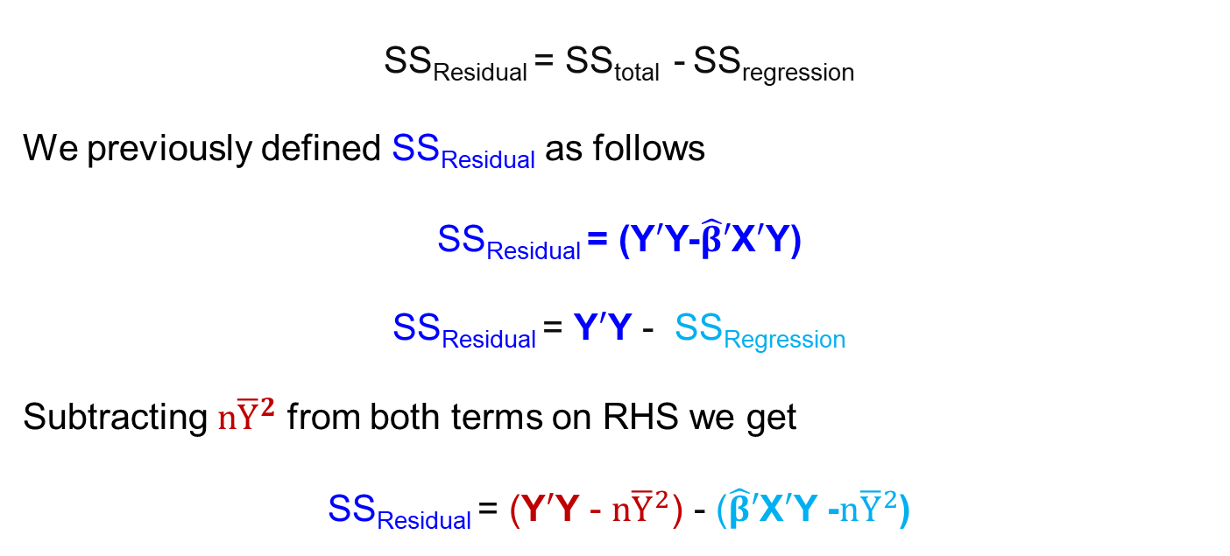
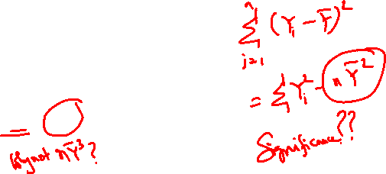
Manipulation of Residual Sum of Squares
SS_{Residual} = SS_{total} - SS_{regression}
We previously defined SS_{Residual} as follows
SS_{Residual} = (Y$′$Y-$\hat{β}′$X$′$Y)
SS_{Residual} = Y$′$Y - SS_{Regression}
Subtracting $n{\overline{Y}}^{2}$ from both terms on RHS we get
SS_{Residual} = (Y$′$Y - $n{\overline{Y}}^{2}$) - ($\hat{β}′$X$′$Y -$n{\overline{Y}}^{2}$)

Slide 23
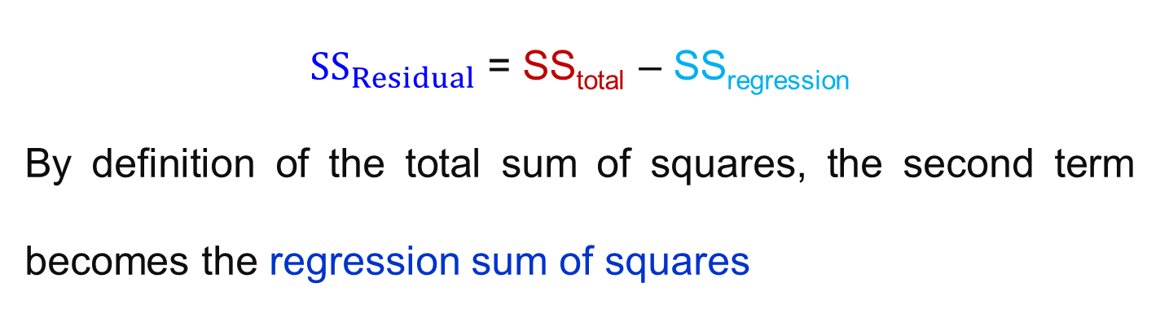

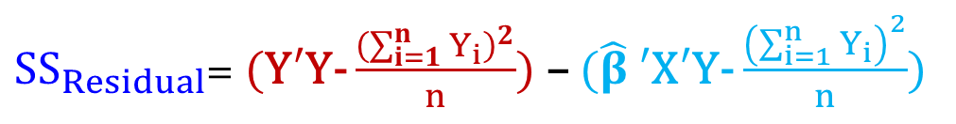
Resolution of Error Sum of Squares
${SS}_{Residual}$ = (Y$′$Y-$\hat{β}′$X$′$Y)
${SS}_{Residual}$= (Y$′$Y- $\frac{{\left(\sum_{i=1}^{n}{Y_{i}}\right)}^{2}}{n}$) – ($\hat{β}$ $′$X$′$Y- $\frac{{\left(\sum_{i=1}^{n}{Y_{i}}\right)}^{2}}{n}$)
${SS}_{Residual}$ = SS_{total} – SS_{regression}
By definition of the total sum of squares, the second term becomes the regression sum of squares

Slide 24
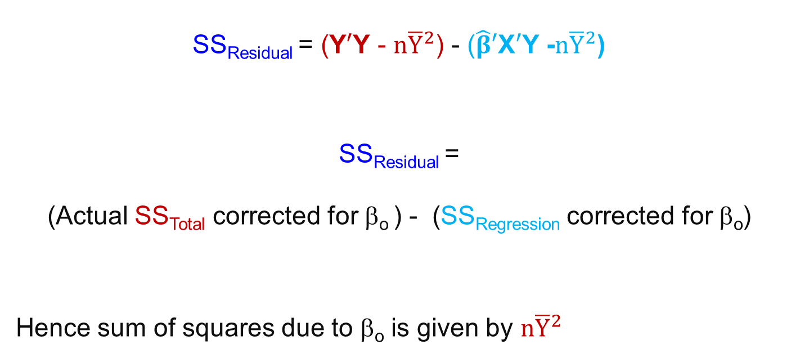
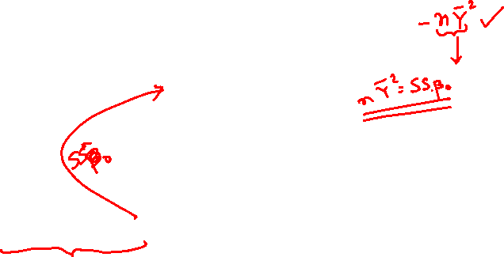
Manipulation of Residual Sum of Squares
SS_{Residual} = (Y$′$Y - $n{\overline{Y}}^{2}$) - ($\hat{β}′$X$′$Y -$n{\overline{Y}}^{2}$)
SS_{Residual} =
(Actual SS_{Total} corrected for β_{o} ) - (SS_{Regression} corrected for β_{o})
Hence sum of squares due to β_{o} is given by $n{\overline{Y}}^{2}$

Slide 25

Total Sum of Squares
Total Sum of Squares: $Y^{′}Y−\frac{{\left(\sum_{i=1}^{n}{Y_{i}}\right)}^{2}}{n}$
The actual total sum of squares is Y$′$Y.
The term $n{\overline{Y}}^{2}=\frac{{\left(\sum_{i=1}^{n}{Y_{i}}\right)}^{2}}{n}$ is deducted from the actual total sum of squares.

Slide 26
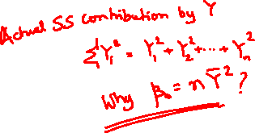
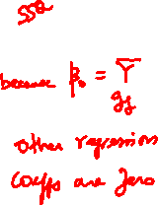
Regression Sum of Squares due to Partial Regression Coefficients
The regression sum of squares does NOT include the intercept β₀ contribution and
Has contributions only from β₁, β₂, β₃, … β_{k}.
Hence the degrees of freedom for this regression sum of squares is k (= p-1).

Slide 27

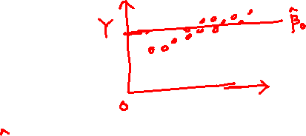
Regression Sum of Squares due to β₀
Another way of looking at this is as follows
If we fit a model containing only β₀ , the fitted model is
$$\hat{Y}=\overline{Y}$$
or
$$β_{o}= \overline{Y}$$
There is no contribution from the predictors

Slide 28


Regression Sum of Squares due to β₀
$$β_{o}= \overline{Y}$$
There is no contribution from the predictors
Hence sum of squares due to $β_{o}$ is
$$\sum_{i=1}^{n}{{\overline{Y}}^{2}}=n{\overline{Y}}^{2}$$

Slide 29
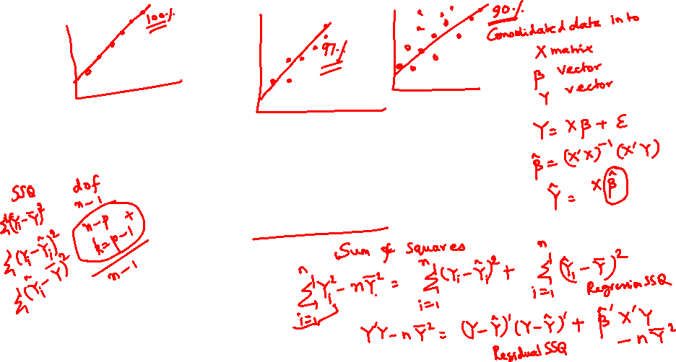
Metrics of Regression : How Good is my Fit?

Slide 30
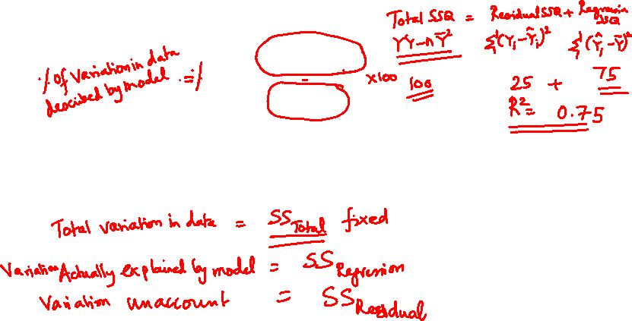
Coefficient of Determination (R²):
This represents the proportion of the total variability accounted or explained by the linear regression model

Slide 31

Coefficient of Determination (R²):
The R² value may be increased by increasing the number of terms in the model and thereby increasing the number of coefficients that may be adjusted so that the model can be made to fit the data excellently.

Slide 32
Coefficient of Determination (R²):
A complex model becomes cumbersome to handle, more empirical in nature and difficult to ascribe physical reasons for the dependence of the response on the factors of the experiment.
A noisy data fitted with too many parameters will fail to work well when implemented.

Slide 33
Adjusted R²:
Here Mean Squares of the error and model/total sum of squares are used.

Slide 34
Adjusted R²:
To penalize the addition of unnecessary terms in the model equation (“overfitting”) the adjusted R² value also gets reported.

Slide 35
Adjusted R²:
The SS_{Error} contribution is increased by dividing with the error degrees of freedom. The latter reduces when more number of parameters are taken up by the model.

Slide 36
Adjusted R²:
Unless the SS_{Error} is considerably reduced by adding the extra term to the model equation, the adjusted R² will increase upon increasing the number of parameters.

Slide 37
PRESS: Prediction Error Sum of Squares
This term is also similar to the sum of squares of the residuals.
We sum the square of the deviations between the actual responses and the corresponding model predicted values.

Slide 38
PRESS: Prediction Error Sum of Squares
The main difference to watch out for is that the prediction for the i^{th} data is based on a model equation that excluded that particular data point but used the remaining data points to develop the model equation.

Slide 39
PRESS: Prediction Error Sum of Squares
The same treatment is meted to other data points as well when they are compared to their individual model predictions.

Slide 40

PRESS:
First H matrix is defined as follows
$$H={X\left(X^{′}X\right)}^{−1}X^{′}$$
Let us define the usual residual
$$e_{i}=(y_{i}−{\hat{y}}_{i})$$
The PRESS residual $e_{(i)}$ may be related to $e_{i}$ as
$$e_{(i)}=e_{i}/(1−h_{ii})$$
Here, $h_{ii}$ refers to the diagonal elements of H.

Slide 41

PRESS:
The PRESS residual $e_{(i)}$ may be related to $e_{i}$ as
$$e_{(i)}=\frac{e_{i}}{1−h_{ii}}$$
Here, $h_{ii}$ refers to the diagonal elements of H
$$PRESS= \sum_{i=1}^{n}{{\left(\frac{e_{i}}{1−h_{ii}}\right)}^{2}}$$
$$R_{PRESS}^{2}=1−\frac{PRESS}{SSTotal}$$
Remember to adjust for intercept when finding total sum of squares

Slide 42

Variance-Covariance Matrix
The variance-covariances of the least square estimators of the parameters$\hat{β}$ including ${\hat{β}}_{0}$ are the elements of the (X$′$X)⁻¹ matrix multiplied by the variance σ².
(X$′$X)⁻¹ σ² is termed as the
Variance-Covariance matrix.

Slide 43
Variance-Covariance Matrix
The diagonal elements of the Covariance matrix are the variances of the least square estimators and the off-diagonal elements are the covariances.
The Covariance matrix dimensions are p x p

Slide 44

Form of the Variance-Covariance Matrix

Slide 45



Matrix Form of the Regression Equations
This is a symmetric matrix
(C₁₀=C₀₁, C₂₀=C₀₂, and C₂₁=C₁₂) as (X$′$X)⁻¹ is symmetric.
$`V$($\hat{β}$)$=^{1}C_{jj}, j=0,1,2$
$Cov$(${\hat{β}}_{i}{\hat{,β}}_{j}$)$=^{1}C_{ij}, i,j=0,1,2, i$≠j

Slide 46

Significance of the Covariance Matrix
The estimates of the variances of these estimated regression coefficients are obtained by replacing σ² with an estimate ${\hat{σ}}^{2}$as σ² is unknown.

Slide 47

Estimated Standard Error
When σ² is replaced by its estimate ${\hat{σ}}^{2}$, the square root of the estimated variance of the j^{th} regression coefficient is called the estimated standard error of the least squares estimator ${\hat{β}}_{j}$

Slide 48

Significance of the Covariance Matrix
The estimated standard error of the least squares estimator is given by
$$se({\hat{β}}_{j})=\sqrt{{{\hat{σ}}^{2}C}_{jj}}$$

Slide 49
Significance of the Covariance Matrix
These standard errors are a measure of the precision of the estimation for the regression coefficients
Small standard errors imply good precision.

Slide 50
Estimator of Standard Error
The estimation of residual error is important
The residual should ideally reflect the difference due to random factors and not systematic discrepancies created by using an inadequate model.
This is an unbiased estimator of σ²

Slide 51


Estimator of Residual Variance
$${\hat{σ}}^{2}=\frac{\sum_{i=1}^{n}{{e_{i}}^{2}}}{n−p}=\frac{{SS}_{E}}{n−p}$$
$${SS}_{E}= \sum_{i=1}^{n}{{\left(Y_{i}−{\hat{Y}}_{i}\right)}^{2}}$$

Slide 52

Standard Error
$$se({\hat{β}}_{j})=\sqrt{{{\hat{σ}}^{2}C}_{jj}}$$
Compare the standard errors $se({\hat{β}}_{j})$with the estimated coefficients ${\hat{β}}_{j}$ and if the standard errors are much smaller than these coefficients, the precision of estimation is reasonably good.

Slide 53
Tutorial Problem
For the conveyor belt problem find
R²
Adjusted R²
PRESS
Variance – Covariance Matrix
Standard Error of the Estimated Parameters

Slide 54
Relevant Results
For the conveyor belt problem find
R²
Adjusted R²
PRESS
Variance – Covariance Matrix
Standard Error of the Estimated Parameters

Slide 55

a) Coefficient of Determination R²
Previously the total sum of squares and regression sum of squares were actual values viz.
$Actual SS_{Total}=\sum_{i=1}^{n}{Y_{i}^{2}}$ & $Actual SS_{Regression}= ^{′}X^{′}Y$
But we need to use
$SS_{Total}=\sum_{i=1}^{n}{Y_{i}^{2}−n{\overline{Y}}^{2}}$ & $SS_{Regression}=\sum_{i=1}^{n}{β^{′}X^{′}Y−n{\overline{Y}}^{2}}$
If you may recall, we are removing the effect of the intercept β_{o} and focussing on the partial regression coefficients.

Slide 56

a) Coefficient of Determination (R²):
From Matlab we get the following results for the II order model
$$R^{2}=\frac{SS_{Regression}}{SS_{Total}}$$

Slide 57
a) Coefficient of Determination R²
Previously the total sum of squares and regression sum of squares were actual values viz.
$Actual SS_{Total}=\sum_{i=1}^{n}{Y_{i}^{2}}$ & $Actual SS_{Regression}= ^{′}X^{′}Y$
But we need to use
$SS_{Total}=\sum_{i=1}^{n}{Y_{i}^{2}−n{\overline{Y}}^{2}}$ & $SS_{Regression}=\sum_{i=1}^{n}{β^{′}X^{′}Y−n{\overline{Y}}^{2}}$
If you may recall, we are removing the effect of the intercept β_{o} and focussing on the partial regression coefficients.

Slide 58
% For II order model find Total and Regression Sum of Squares
SS_Total = Y'*Y-numel(Y)*mean(Y)^2; % 228.9091
SS_Regression = beta_hat'*X'*Y-numel(Y)*mean(Y)^2; % 221.6775
% numel(Y) = 11 value of n
n=numel(Y); % n=11
R2_IIorderModel = SS_Regression /SS_Total; % R2 = 0.9684

Slide 59


a) Coefficient of Determination (R²):
$$R^{2}=\frac{SS_{Regression}}{SS_{Total}}$$
From Matlab we get the following results for the II order model
$$R^{2}=\frac{\text{221.6775 }}{228.9091}=0.9684$$

Slide 60


b) Adjusted R²
% Next to find Adjusted R^2
p = numel (beta_hat) % 3
R2Adj_IIoderModel = 1 - (RsSSQ1/(n-p))/(SS_Total/(n-1));
% R2_Adj = 0.9605
$${Adj. R}^{2}=1−\frac{\frac{SS_{Residual}}{n−p}}{\frac{SS_{Total}}{n−1}}$$
${Adj. R}^{2}=1−\frac{\frac{7.2316}{11−3}}{\frac{228.9091}{11−1}}=0.9605$=

Slide 61
c) PRESS
First H matrix is defined as follows
$$H={X\left(X^{′}X\right)}^{−1}X^{′}$$
Let us define the usual residual
$$e_{i}=(y_{i}−{\hat{y}}_{i})$$
The PRESS residual $e_{(i)}$ may be related to $e_{i}$ as
$$e_{(i)}=e_{i}/(1−h_{ii})$$
Here, $h_{ii}$ refers to the diagonal elements of H.

Slide 62

c) PRESS:
The PRESS residual $e_{(i)}$ may be related to $e_{i}$ as
$$e_{(i)}=\frac{e_{i}}{1−h_{ii}}$$
Here, $h_{ii}$ refers to the diagonal elements of H
$$PRESS= \sum_{i=1}^{n}{{\left(\frac{e_{i}}{1−h_{ii}}\right)}^{2}}$$
$$R_{PRESS}^{2}=1−\frac{PRESS}{{SS}_{Total}}$$
Remember to adjust for intercept when finding total sum of squares

Slide 63
c) PRESS:
% To find PRESS
% First find H Matrices
HX=X*(inv(X'*X))*X';
PRESS_X=0.0;
Res_SSQ2_X=0;
for i=1:numel(Y)
Res_SSQ2_X=Res_SSQ2_X+(Y(i)-Y_Pred(i))^2;
% PRESS Calculations
PRESS_X = PRESS_X + ((Y(i)-Y_Pred(i))/(1-HX(i,i)))^2;
% PRESS = 11.9361 Predicted Sum of Squrares
end
% Find R2 PRESS
R2_PRESS=1-PRESS_X/(Y'*Y-n*(mean(Y))^2);
% R2_PRESSX = 0.9479

Slide 64
d) Variance Covariance Matrix
VarCov_Matrix = (inv(X'*X))*(RsSSQ1/(n-p));
% VarCov_Matrix =
%
% 40.1613 -5.6542 0.1898
% -5.6542 0.8061 -0.0273
% 0.1898 -0.0273 0.0009
% Note the symmetric nature of the Variance-Covariance Matrix

Slide 65
e) Standard Errors of the Estimated Parameters
VarCov_Matrix = (inv(X'*X))*(RsSSQ1/(n-p));
% RsSSQ1/(n-p) = 0.9039
% Get the diagonal elements
Var_BetaHat = diag(diag(VarCov_Matrix));
% Var_BetaHat =
%
% 40.1613 0 0
% 0 0.8061 0
% 0 0 0.0009
StdError_Beta=sqrt(Var_BetaHat);
% StdError_Beta =
%
% 6.3373 0 0
% 0 0.8979 0
% 0 0 0.0306

